Slide 1
UNIFIED-IO: By
Sri Kalyan Reddy Akiti

Slide 2
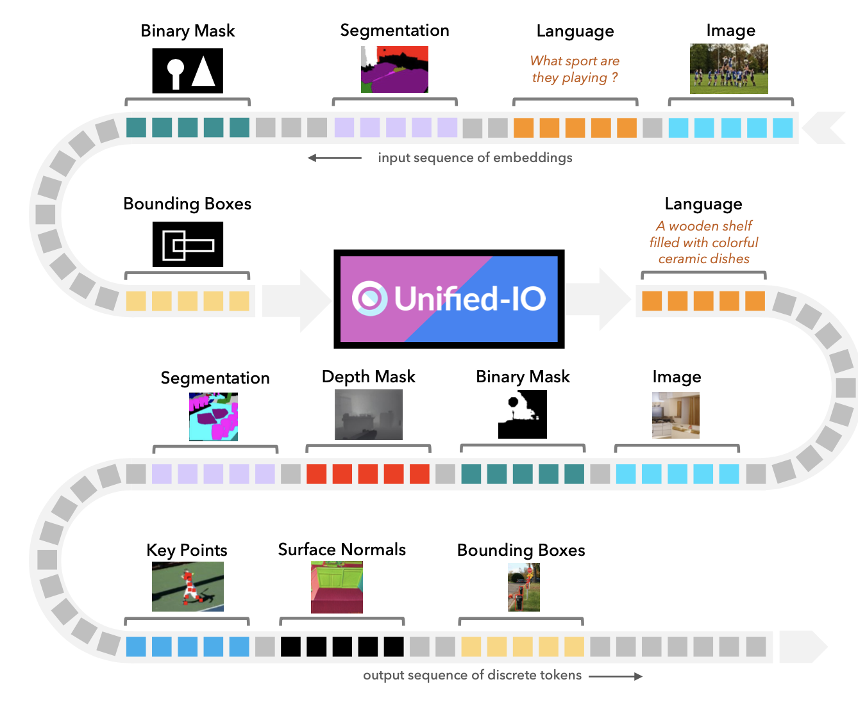
UNIFIED-IO: A Versatile AI Model
UNIFIED-IO is a groundbreaking AI model designed to tackle a vast array of tasks, ranging from traditional computer vision jobs like identifying objects and estimating depth to more complex challenges such as generating images and understanding language. What sets UNIFIED-IO apart is its ability to handle this diverse range of tasks using a single, unified architecture. By standardizing the input and output formats for each task into sequences of tokens, UNIFIED-IO can be trained jointly on over 90 different datasets, spanning multiple fields in AI. This model represents a significant step forward in AI research, as it achieves strong performance across various benchmarks without the need for task-specific fine-tuning.

Slide 3
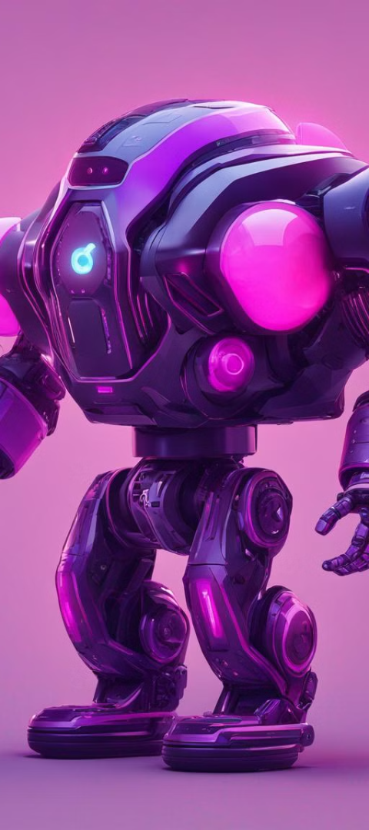
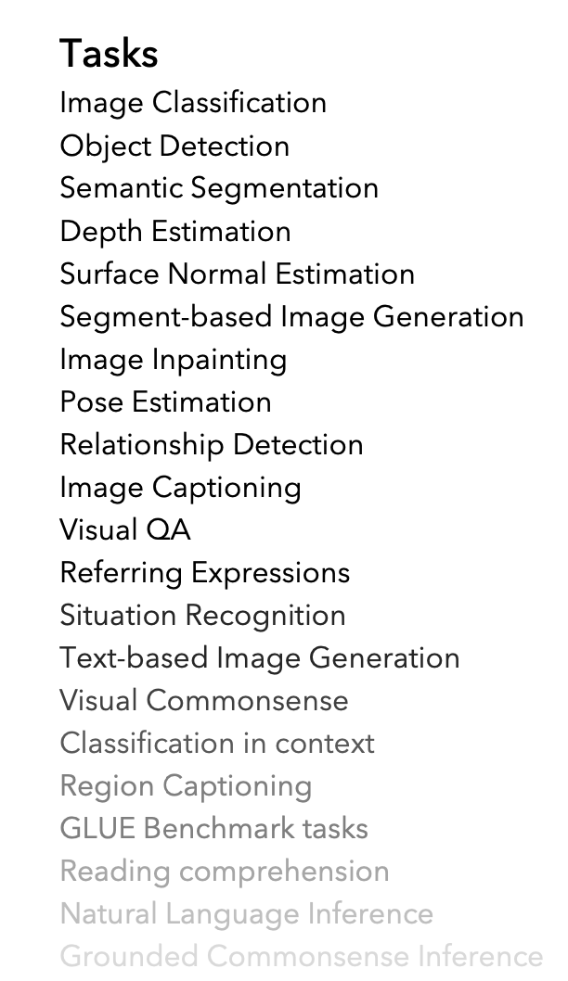
UNIFIED-IO's Versatility
1
Tasks Categorized by Modalities
Tasks are categorized based on the modalities of their inputs and outputs into four main types: Text (natural language tokens), Image (RGB images), Sparse (a small number of location coordinates within images), and Dense (per-pixel labels such as depth maps or semantic segmentation).
2
Eight Overarching Categories
These tasks are further grouped into eight overarching categories and 22 specific tasks to streamline training and analysis.
3
Comprehensive Training Approach
The benchmarks provided illustrates the breadth of tasks and datasets UNIFIED-IO learns from, showcasing the variety of sources, dataset counts, example numbers, and input-output modalities involved across different task groups.

Slide 4
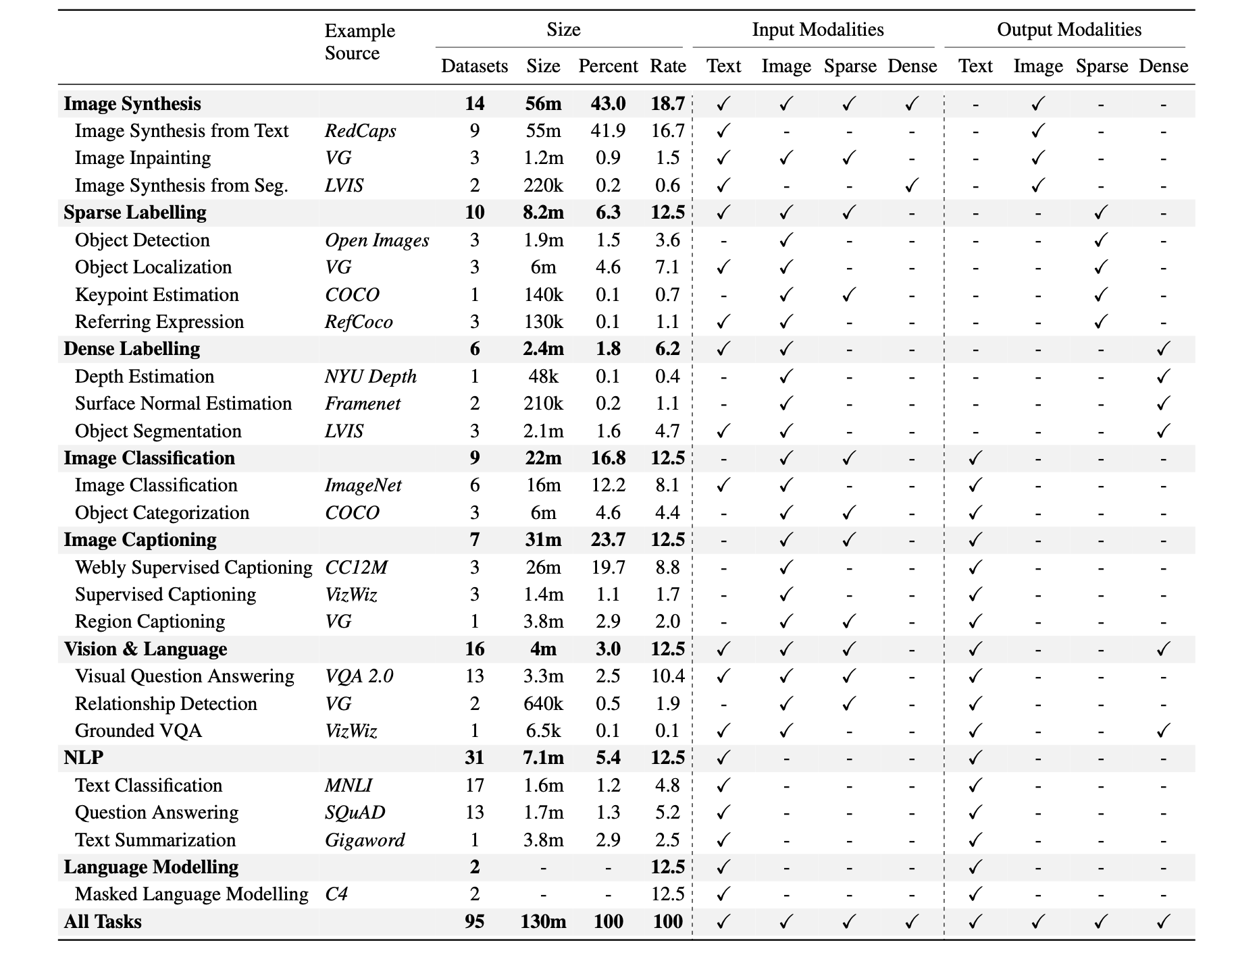

Slide 5
Unified Task Representations
Text Representation
Images and Dense Structures Representation
Sparse Structures Representation
Text inputs and outputs are tokenized using techniques like SentencePiece, with each task specified by a natural language prompt to indicate the intended task.
Sparse structures like bounding boxes or human joints are encoded using special tokens to represent discretized image coordinates, allowing UNIFIED-IO to handle tasks relying on such elements.
For tasks requiring high-dimensional outputs like images or per-pixel labels, UNIFIED-IO converts these outputs into discrete tokens using a VQ-GAN.

Slide 6

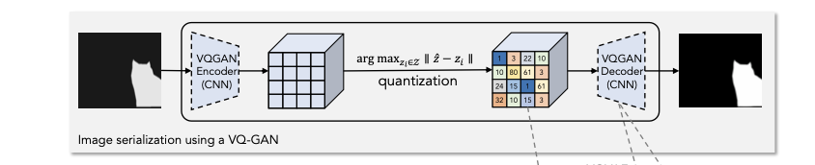
Unified Architecture of UNIFIED-IO
1
Transformer-Based Architecture
2
Architectural Adaptations
UNIFIED-IO adopts a transformer-based architecture, inspired by the success of models like T5 in natural language processing.
Several architectural adaptations are made to accommodate input images and diverse task requirements, such as reshaping images into patches for embedding, expanding the vocabulary to include image tokens, and incorporating position embeddings.

Slide 7
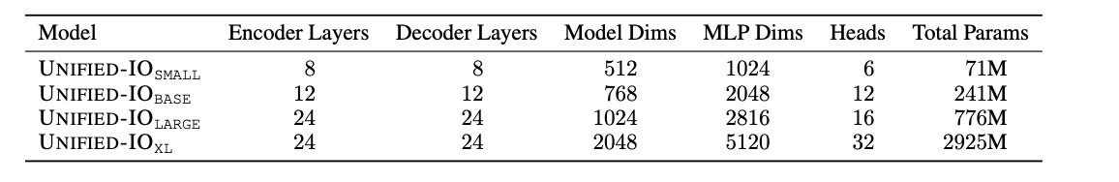
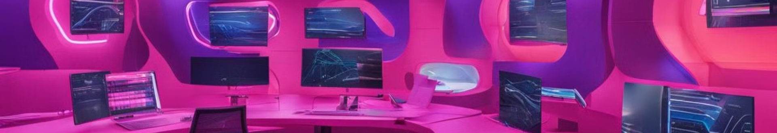


Training and Experiments
Training
Experiments
Training UNIFIED-IO involves two stages: pre-training and massive multi-task training.
In this section, we present a comprehensive analysis of UNIFIED-IO's performance across various benchmarks and tasks, including the GRIT benchmark, ablation experiments, evaluation on additional computer vision and NLP tasks, and discussions on limitations.

Slide 8
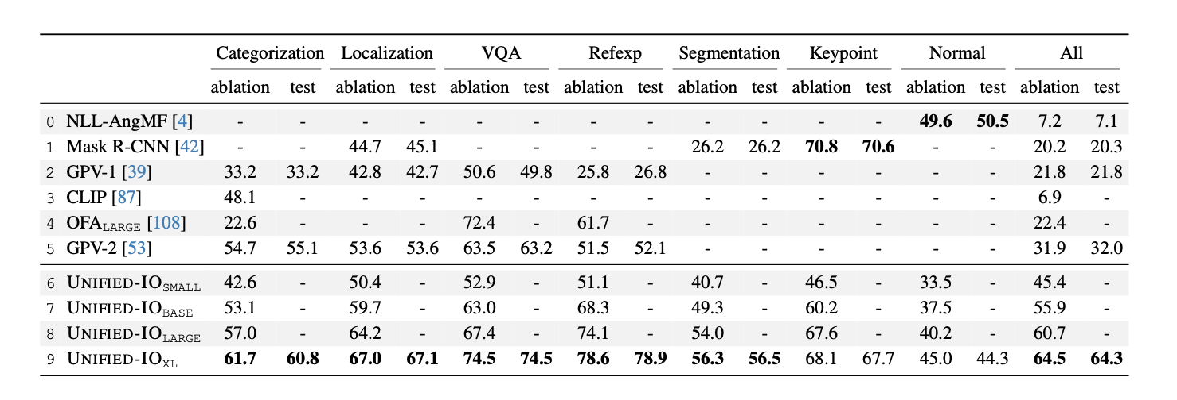
Results and Achievements
Results on GRIT
The GRIT benchmark evaluates models across multiple tasks and modalities, serving as a robust evaluation platform. UNIFIED-IO achieves significant success on GRIT, surpassing all prior submissions by supporting all seven tasks and achieving an average accuracy of 64.3 with the UNIFIED-IOXL model.
Ablations
Ablation experiments provide insights into how multi-task training impacts learning in UNIFIED-IO.

Slide 9
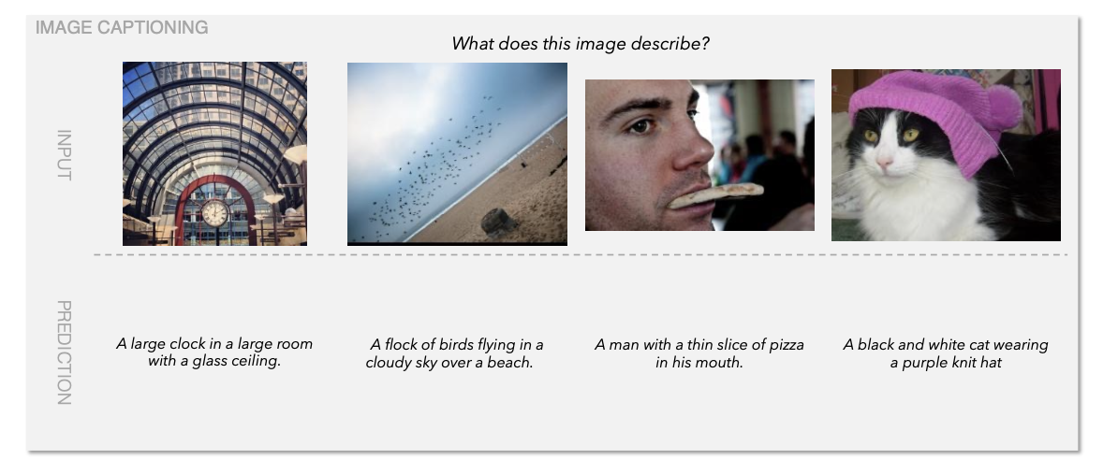
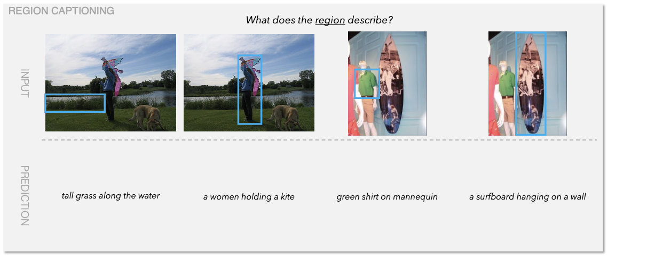

Limitations and Future Development
1
Limitations
2
Future Development
Despite its successes, UNIFIED-IO has limitations. For instance, in object detection, it may struggle with recall in cluttered images due to the lack of extensive data augmentation techniques.
Overall, the experiments provide valuable insights into UNIFIED-IO's performance and areas for future development.

Slide 10

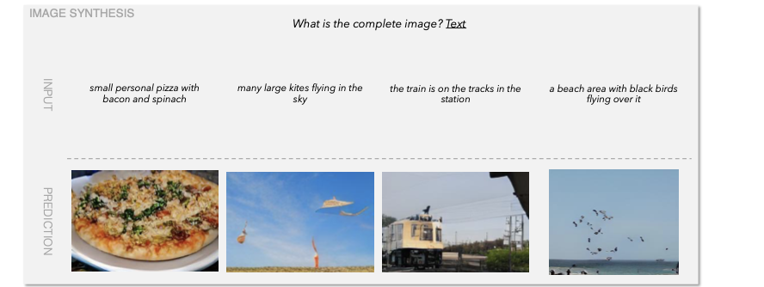
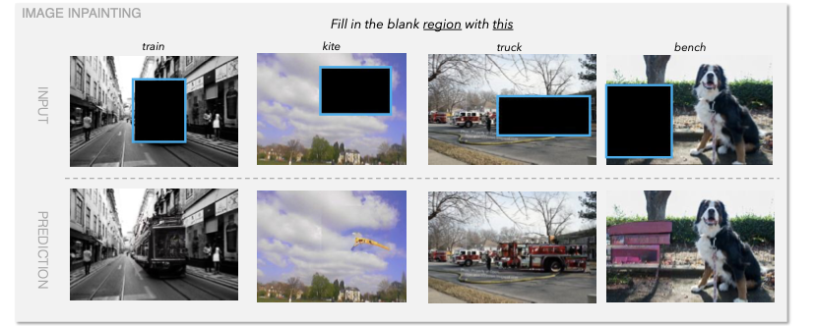
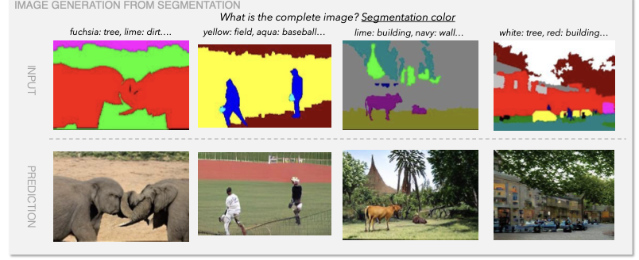
Conclusion and Impact
Related Work
Conclusion
Researchers have long been interested in constructing models capable of learning and solving multiple tasks.
By leveraging a unified architecture and extensive training across diverse datasets, UNIFIED-IO demonstrates the potential for multi-task learning in handling complex and varied tasks in both computer vision and NLP domains.

Slide 11
THANK YOU

